Slide 1

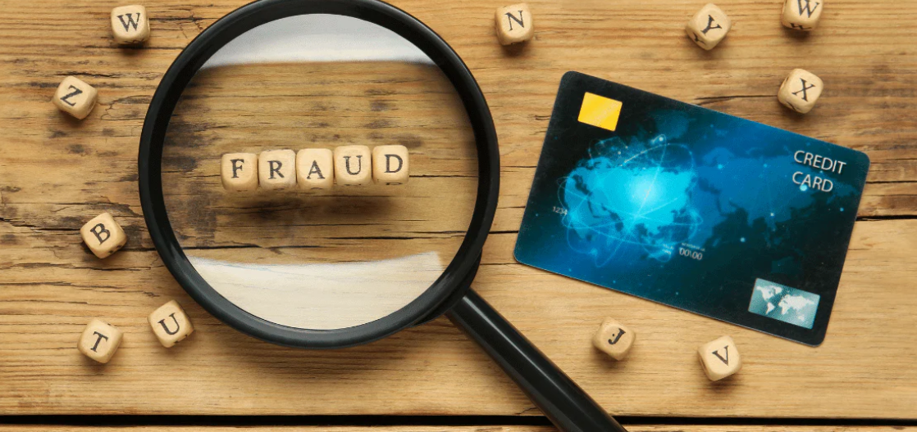
CREDIT CARD FRAUD ANALYTICS Detection and Recommendations

Slide 2

AGENDA
Introduction
Group Members
What is Fraud?
Global Fraud Statistics
Business Requirements
Current Status Evaluation
Organizational Goals
Data Analytics & Visualization
Defining Source Data
Time & Transaction Analysis
Card Types, Modes of Transaction & Currency Analysis
Geolocation Analysis
Conclusion
Recommendations
Executive Summary

Slide 3

Introduction

Slide 4

GROUP MEMBERS
JIMMY KIM
MOUNIKA LINGALA
ERNAWATY ERNAWATY
THET WIN

Slide 5

WHAT IS FRAUD?
DEFINITION
Credit card fraud is an inclusive term for fraud committed using a payment card, such as a credit card or debit card. The purpose may be to obtain goods or services or to make payment to another account, which is controlled by a criminal.
HOW DOES CREDIT CARD FRAUD OCCUR?
Credit card fraud happens when consumers give their credit card number to unfamiliar individuals, when cards are lost or stolen, when mail is diverted from the intended recipient and taken by criminals, or when employees of a business copy the cards or card numbers of a card holder.
Source: https://www.consumer-action.org/downloads/english/Chase_CC_Fraud_Leaders.pdf
Card-present and Card-Not-Present fraud (more common).
A card-not-present transaction (CNP, mail order / telephone order, MO/TO) is a payment card transaction made where the cardholder does not or cannot physically present the card for a merchant's visual examination at the time that an order is given and payment effected. It is most commonly used for payments made over the Internet, but can also be used with mail-order transactions by mail or fax, or over the telephone.
Source: https://en.wikipedia.org/wiki/Card-not-present_transaction

Slide 6

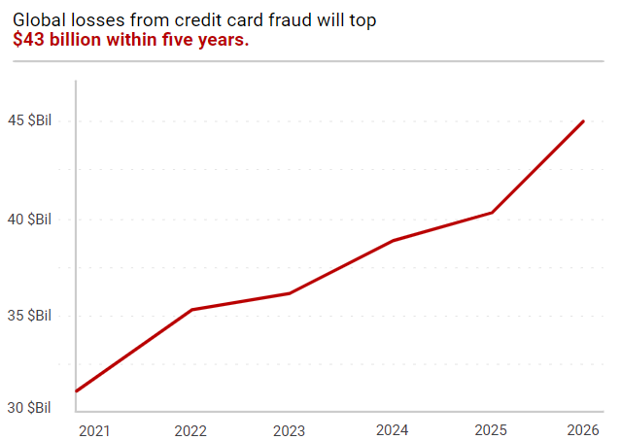
Global Fraud Statistics
Global losses from payment card fraud are projected to reach $43 billion by 2026. And, according to eMarketer, card-not-present (CNP) fraud was responsible for 73% of card payment fraud losses last year. That’s an 8.5% increase over reported losses in 2022.
Source: https://chargebacks911.com/credit-card-fraud-statistics/

Slide 7
Business Requirements

Slide 8
BUSINESS REQUIREMENTS
1) Boost the Volume of Transactions :
Identify and implement strategies to increase the number of legitimate transactions by understanding customer behavior and preferences and developing targeted marketing and promotional campaigns.
2) Optimize Staffing Levels :
Analyze the frequency of suspected fraudulent activities at different times of day to ensure that staffing is both effective and efficient.
3) Brand Analysis :
Determine if specific types of credit cards are more prone to fraudulent activities.
4) Geolocation Analysis :
Pinpoint geographical regions, including specific countries and cities, that exhibit higher rates of fraud.

Slide 9
Data Analytics & Visualization

Slide 10
Defining SOURCE data
This dataset has a total of 8.000 transactions, out of which 3989 have been flagged as suspicious. A flagged account refers to a credit card account that has been marked for further investigation due to suspected fraudulent activities. The scope of the analysis will focus on the following data.
Transaction Date and Time: Analyze transaction patterns over time.
Transaction Amount: High transaction amounts can be a red flag for fraud.
Cardholder Name: Check for inconsistencies in the cardholder’s name across different transactions.
Merchant Category Code (MCC): Certain types of merchants might be more likely to be targeted by fraudsters.
Transaction Location (City or ZIP Code): Transactions from certain locations might be more likely to be fraudulent.
Transaction Currency: Multiple transactions in different currencies can be a sign of fraud.
Card Type: Certain types of cards might be more likely to be used fraudulently.
Transaction ID: Look for patterns in the transaction IDs associated with fraudulent transactions.
Fraud Flag or Label: This is the target variable for the analysis. It indicates whether each transaction is fraudulent.
IP Address: Analyze the IP addresses associated with each transaction

Slide 11
Time & Transaction Analysis

Slide 12
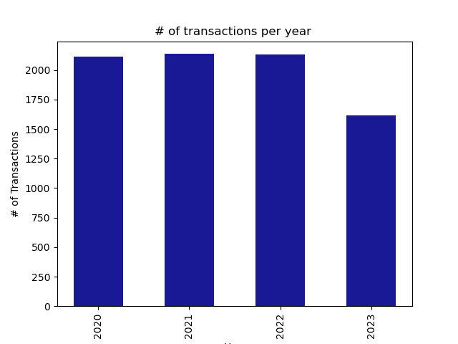
A noticeable decline in credit card transactions is evident in the year 2023. This trend may be attributed to various factors, including:
Economic Shift:
Changes in Consumer Behavior.
Post-COVID-19-Effects
Notes:
Economic changes could have led consumers to reduce their spending, thereby decreasing the volume of credit card transactions.
There might be a shift towards alternative payment methods such as digital wallets or cryptocurrencies, impacting credit card usage.
During the COVID-19 pandemic, consumers were more inclined to use credit cards for transactions. However, as the situation normalized in 2023, there may have been a resurgence in in-person cash transactions.
These hypotheses, while plausible, are speculative due to the constraints of the dataset. Further investigation is recommended to confirm these assumptions and develop strategies to address the decline in credit card transactions.

Slide 13
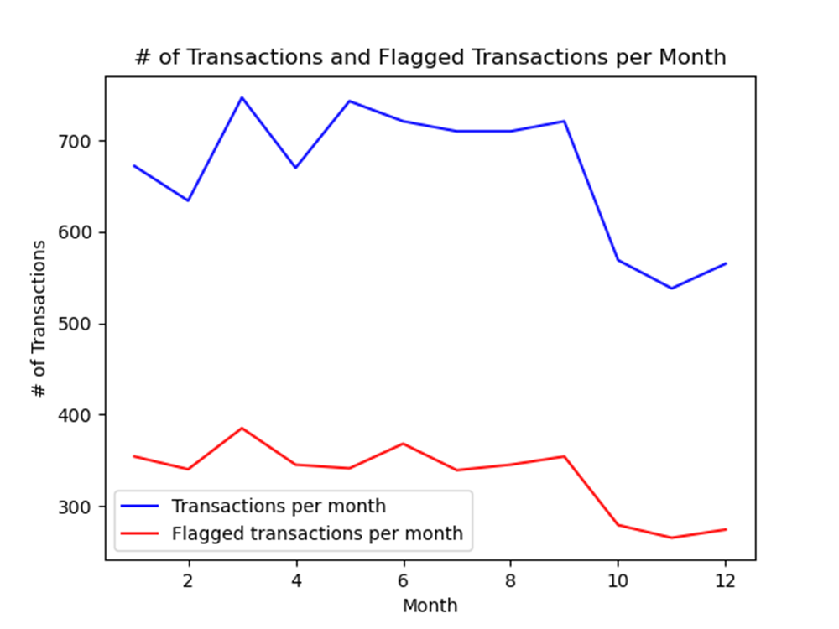
A significant contraction in user transactions starts in September and continues through year-end, with a similar trend observed in flagged transactions.

Slide 14
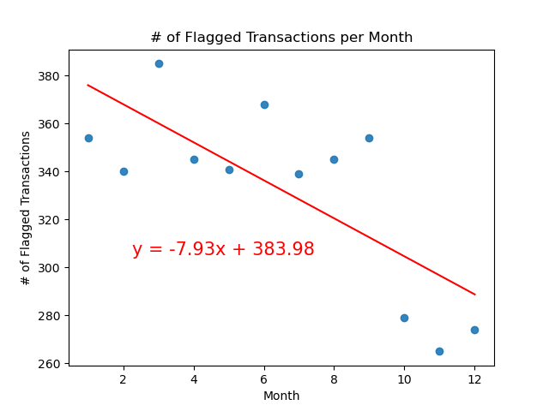
There is a strong negative correlation (r-value of -0.74) between the month and the number of flagged transactions, suggesting a decrease over time.

Slide 15
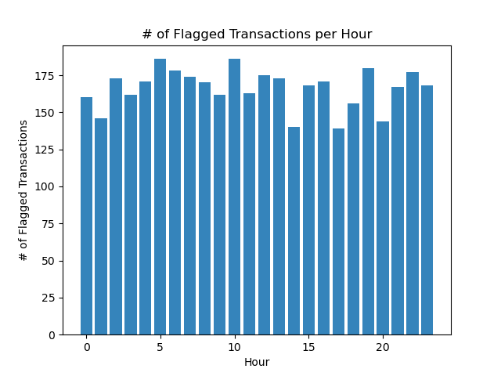
The highest number of flagged transactions occur at 5:00am, 10:00am, and 7:00pm.

Slide 16
Card Types, Modes of Transaction & Currency Analysis

Slide 17
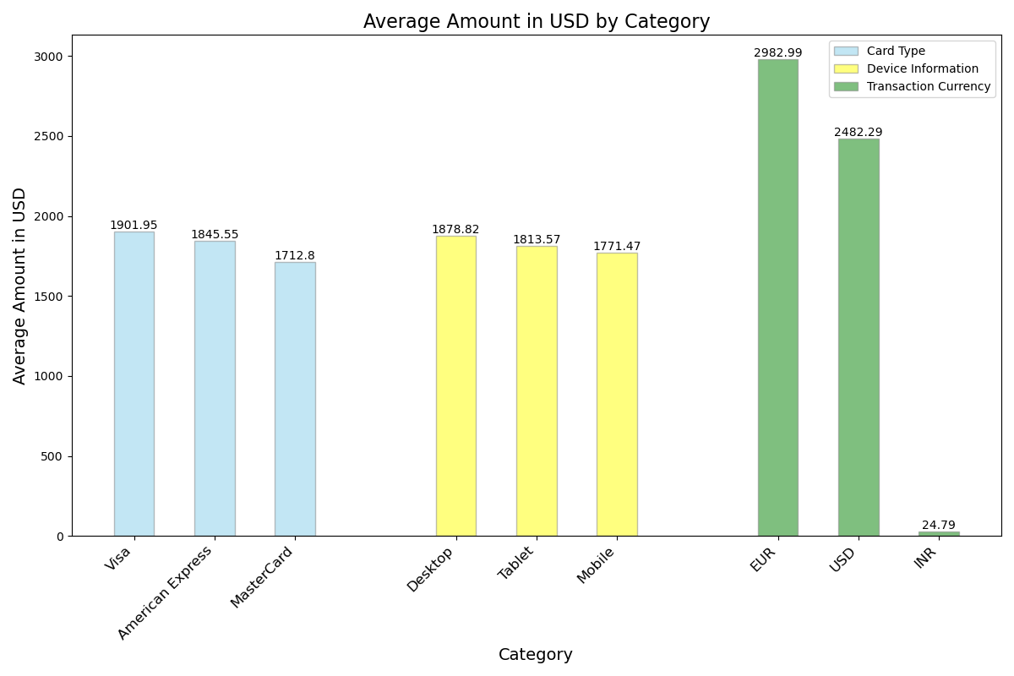
Visa has the highest average transaction amount for flagged transactions, followed by American Express and MasterCard
Transactions made from desktops have the highest average amount, followed by tablets and mobiles.
Transactions in EUR have the highest average amount, followed by USD. Transactions in INR have significantly lower average amounts.

Slide 18
The categories most frequently flagged are Government Services, Miscellaneous Stores and Agriculture Services.

Slide 19
Geolocation Analysis

Slide 20
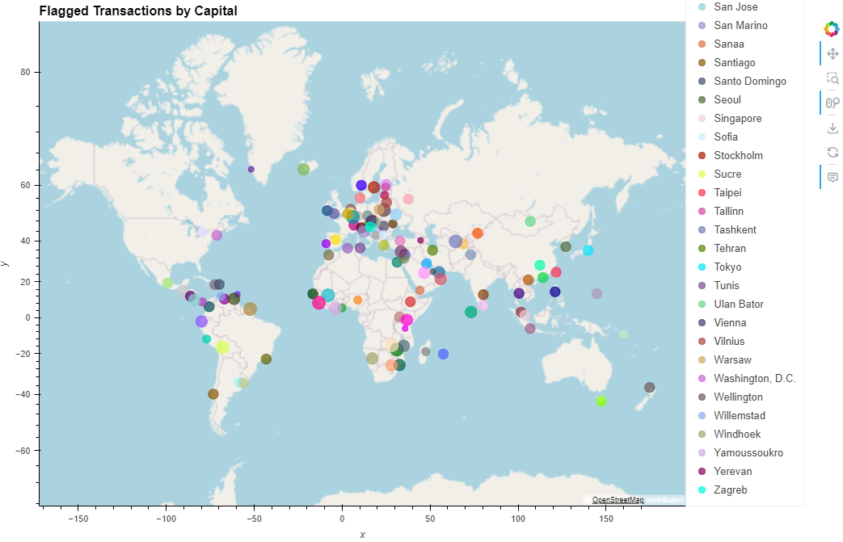
Most flagged transactions occur in Europe, followed by Asia and Africa

Slide 21
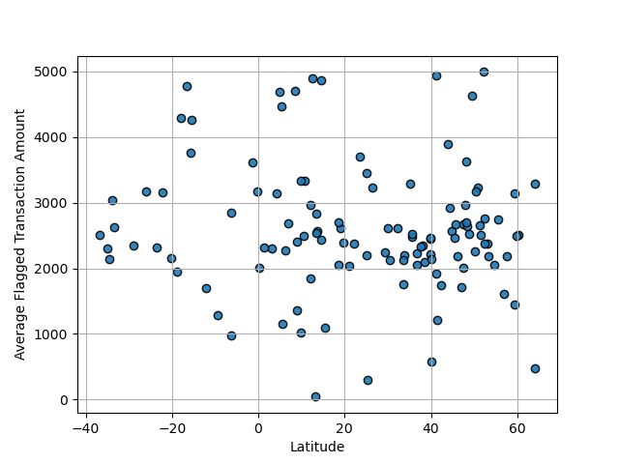
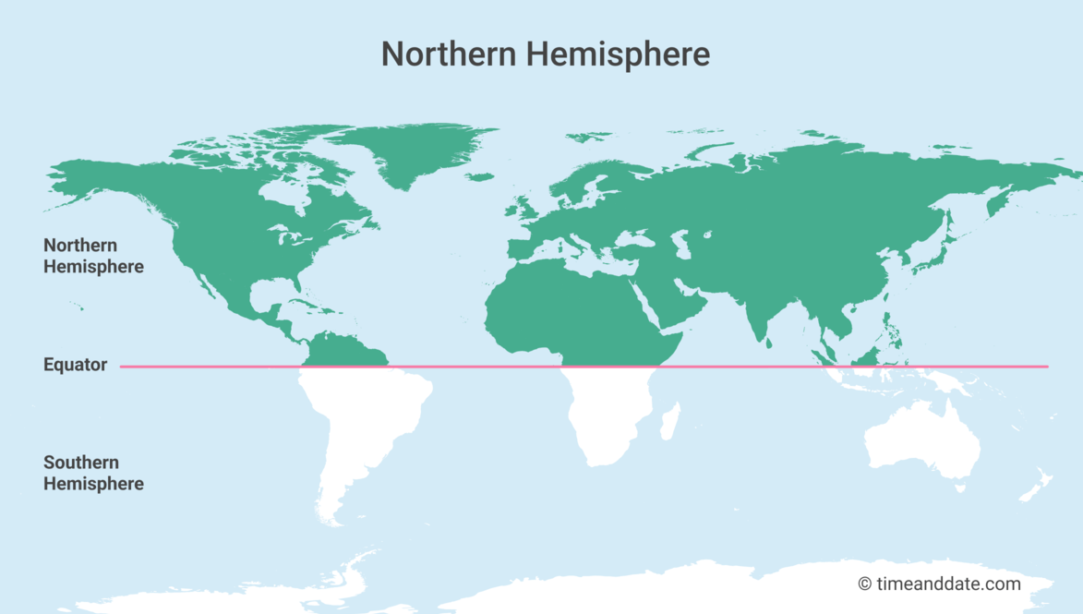
Countries within the Northern Hemisphere are at higher risk of fraudulent activities.

Slide 22
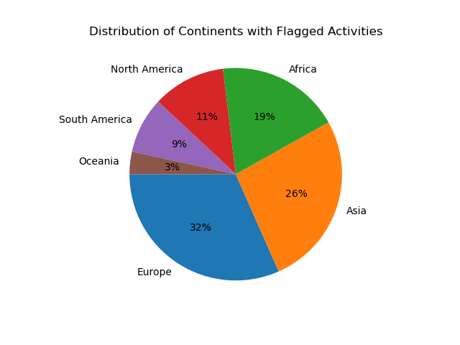
Europe had the most activities followed by Asia and Africa.

Slide 23
Conclusion

Slide 24
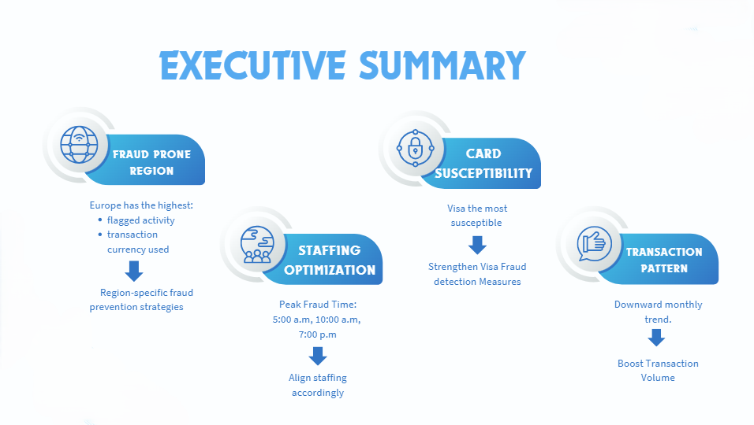

Slide 25
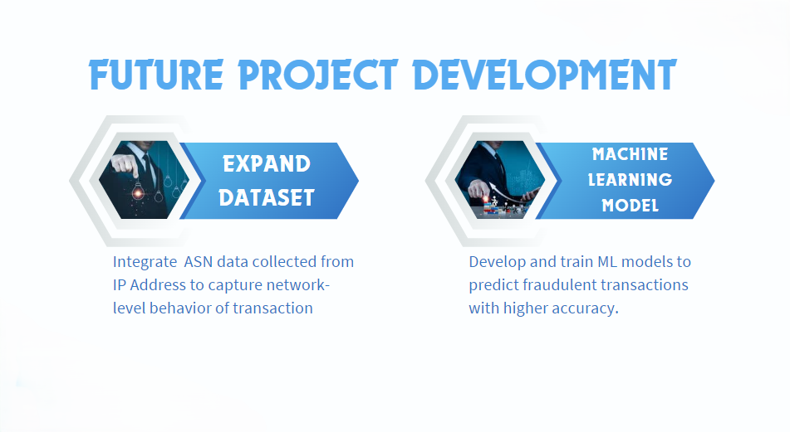

Slide 26

THANK YOU ANY QUESTIONS?
Group 2
JIMMY KIM
MOUNIKA LINGALA
ERNAWATY ERNAWATY
THET WIN

